Slide 1
One/Few Shot Learning
Problem: Accurately classifying foreign military assets given a single/few labelled samples
Conventional deep learning models trained to recognise specific objects (i.e. Is this X?)
Low generalising ability, unfeasible
Notes:
Good morning, my name is Brandon and I’ll be sharing on my project which is about few shot, or one shot learning. Few Shot Learning is a sub-area of machine learning that can be used in Computer Vision tasks, such as image classification. Unlike traditional machine learning algorithms that work on large datasets, few shot tasks are defined as those where there are few data samples available. It is clear that highly accurate classifiers can be built given a large enough dataset. However, some datasets may be very limited, for example, a rare bone disease might have few X-rays available for study, or in the case of this project, a foreign military asset might have few images in the database.
These cases cannot be solved in the same way as conventional deep learning.

Slide 2
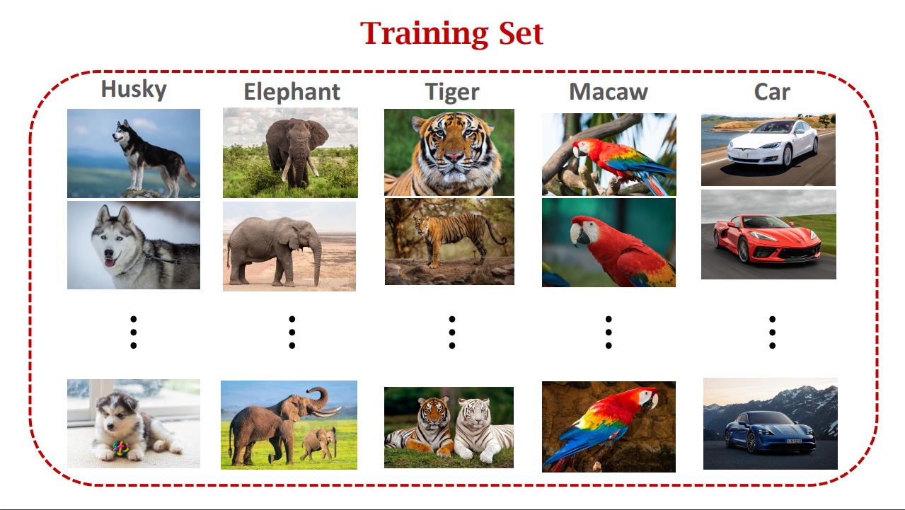
Notes:
In traditional deep learning, the machine is tasked with recognising a preset list of classes, or objects. Beyond that, it is relatively useless. Such a model is trained on a large dataset of images of each class.

Slide 3
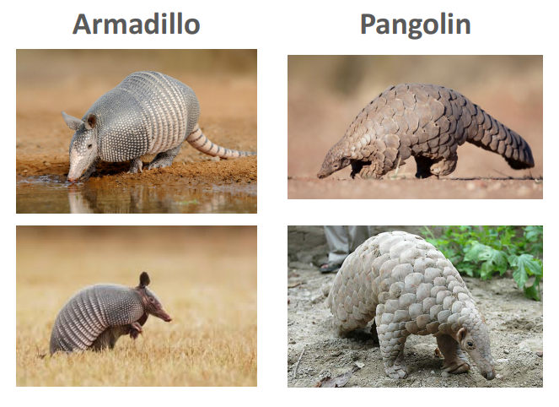
An Example: 2-shot 2-way Task
Notes:
That being said, if we think about it, the human mind somehow has the ability to perform few shot tasks quickly and accurately. Consider the following pictures, which represent a 2-way 2-shot task.

Slide 4
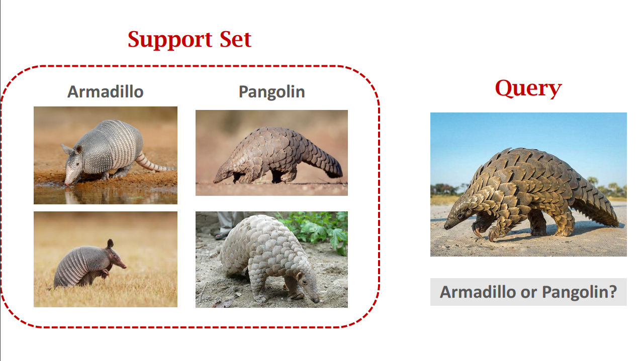
An Example: 2-way 2-shot Task
Notes:
This is known as a support set. The number of ways and shots are determined by the support set. 2-way means that it contains 2 classes: the Armadillo and Pangolin.
2-shot means that each class contains two positive samples.
The support set is what the model uses after we have trained it to determine which class some image belongs to.
Note that the model is not trained on any of the classes in the support set.

Slide 5
Notes:
If we are given these set of images, and following that we are given an image of unknown class, known as the query image, we realise that as humans we easily figure out which class within the support set that the image belongs to, even without having seen an armadillo or pangolin before.
So in this case, the answer would be pangolin. But how do we arrive at this answer so quickly?

Slide 6
Learning to learn
Notes:
Taking a closer look, we realise that the brain is able to accurately accomplish a few shot task because it is in a sense, 'cheating'.
It has likely seen millions of other animals, or even other unrelated objects, and trained itself to differentiate any 2 objects.
We can say that the brain has learnt to learn. This is the key finding that will allow us to train machines for few shot tasks.
Meta learning, or learning to learn, means that a model learns the reason behind classification decisions, rather than a rote approach in the case of conventional deep learning. In this case, the reason our brains can tell if an unknown object belongs to some class is due to the similarity between the two.

Slide 7
Notes:
We were able to tell that the animal in the query image was a pangolin because of the scales on its body, which are present in the pangolin support images but not in the armadillo images.

Slide 8
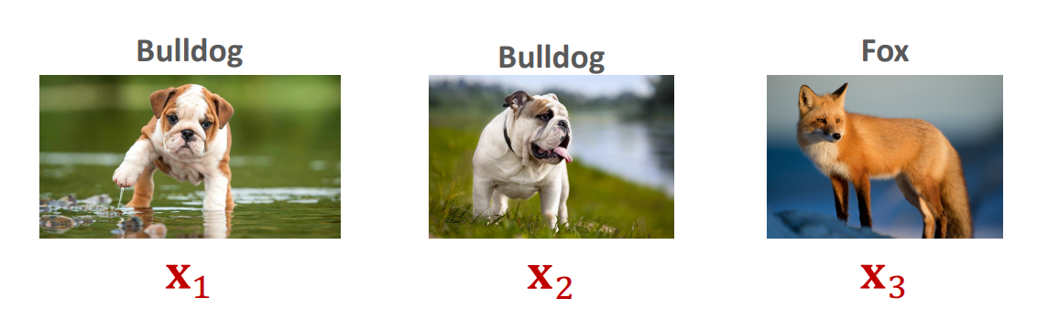
Solution
Train a model to differentiate objects, i.e. Is X similar to Y?
High generalising ability, feasible
f(x₁, x₂) = 1, f(x₁, x₃) = 0, f(x₂, x₃) = 0
Notes:
Hence, if we change the way we label our samples such that each pair of image would be a positive sample if they belong to the same class, and a negative sample they did not, we are able to alter the model's goal to detecting the similarity of 2 images. This eliminates the need to train our model with samples of the rare class. We can use other classes which we have large datasets of to meta learn.
In this example, we have 2 images of a bulldog and 1 of a fox. So, the first and second images would be labelled 1 since they are both of the class ‘bulldog’, while the first and last images and the second and last images would be labelled 0.

Slide 9
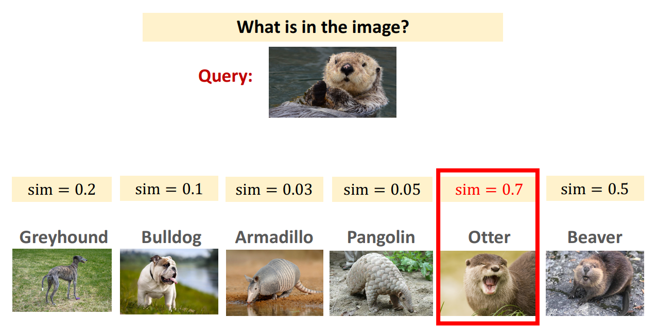
Notes:
After learning, we can input unseen images from a rare class, and use the few samples that we have and ask our model how similar they were, and this would yield a useful output.
Before going through this slide in detail, let me briefly summarise the intuition of few shot learning.

Slide 10
Summary
Problem: classify object(s) that have one or few labelled samples available
Solution: train a model to differentiate two objects
Usage: form a support set with the few image(s) we have of the rare object
Notes:
1. We want a model to recognise some rare objects where we may only have 1 or few images available
2. We can train our model on other classes that we have abundant data of. To do this, we pair the images up and label them based on whether the two images are of the same class.
3. After training, we can input a few shot task to the model. A few shot task consists of a query image, which is the image we would like to classify, and a support set, which contains images of known classes. Think of a few shot task like a multiple choice question. The query image represents the question, and the classes in the support set are the possible choices, where one of them is the correct answer. Just to reiterate, the model is not trained on any of the classes of the support set or the query image.

Slide 11
An Example: 6-way 1-shot
Notes:
So back to the slide, we have a query image at the top, and the images below represent the support set for this task. In this case, the task is 6-way 1-shot, since there are 6 possible classes, and each has a single image. We pair the query image with each image of the support set, and feed it into the model that outputs a similarity score, and the final prediction would be the class of the image with the highest score.

Slide 12
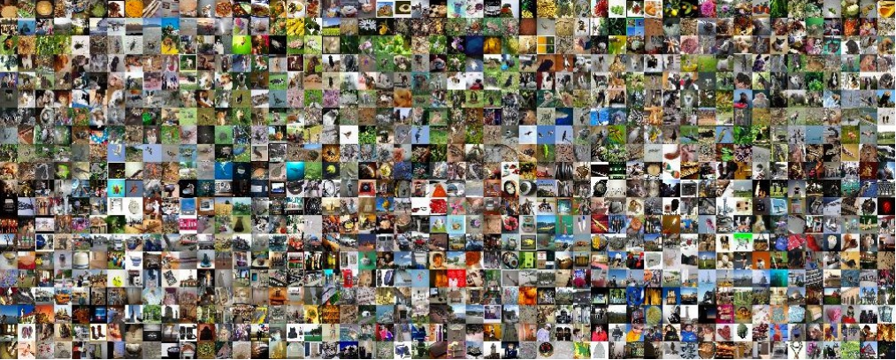
nC2 samples!
1000C2 = 499500
Notes:
One advantage of setting up our training inputs in this way is that we can potentially increase the number of training samples beyond the size of the original dataset. If we were to pair up every image in a dataset of n images, we can see that it results in n choose 2 number of samples.
Of course, this is just an upper limit; if we were to do this, we would most likely get a non-uniform distribution of our training space as there would be many more negative samples than positive. However, the point remains that by pairing them up we can get a significant increase in the number of training samples.

Slide 13
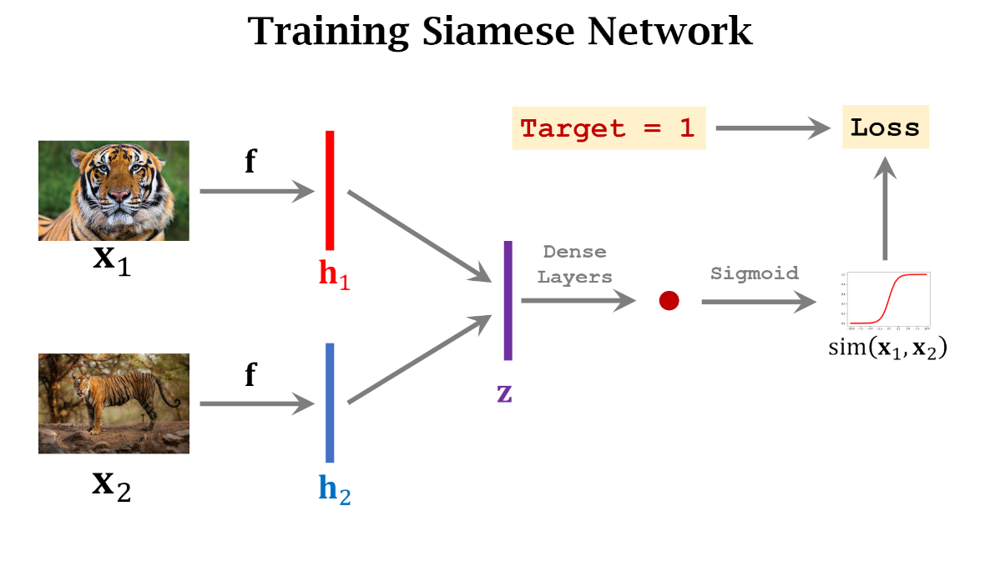
Notes:
As we have discussed, for our model to learn a similarity function, we have to consider pairs of images as the input instead of individual images. This can be done using a siamese network.
The training flow of the siamese network is as follows:
First, input the pair of images of a sample into the same neural network, shown in the diagram as f
The resulting output would be 2 feature vectors, h1 and h2, one for each image of the pair
We then apply some distance function to the two vectors, such as taking the absolute value of h1 - h2 to obtain a single vector z
Then, pass z through a dense layer that outputs a number, which can be used to compute a similarity score by applying the sigmoid function
We calculate the loss between the sample label and the similarity value
And repeat for all samples in our dataset

Slide 14
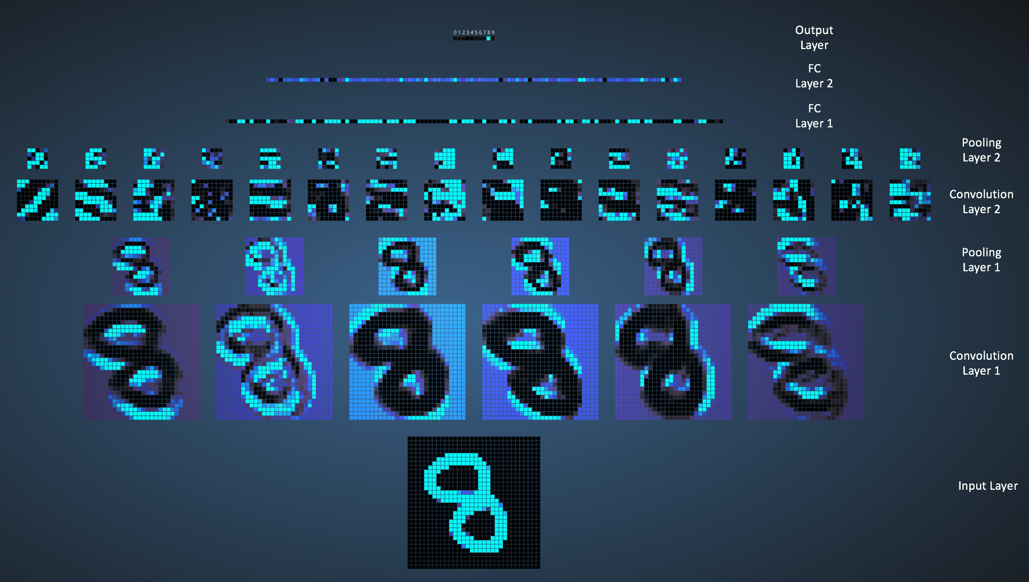
Notes:
So as we have established that few shot algorithms are not too dissimilar from traditional deep learning methods, we have to first understand how traditional image classification is achieved through convolutional neural networks.
Due to the nature of images, where the important information within an image is concentrated in localised regions, we can use the concept of filters to scan the image and try to extract the important features and reduce the dimensionality of our input.
Convolutions and pooling layers are essentially filters, the only difference is that convolutions are variable filters while pooling layers are fixed, meaning that convolutions can be trained to extract the most important features.
Multiple such layers may be used in a neural network, with the idea that each subsequent layer deals with increasingly finer and more abstract features of an image, leading to greater accuracy of the model.
The image in the slide is a good way to visualise this concept. We start with an input image of the number 8 at the bottom, and we can see the first layer filters out the curves and edges. As the layers go further though, we can no longer tell what features are being extracted. We can also see the size of the input decreasing as we go deeper into the network.

Slide 15
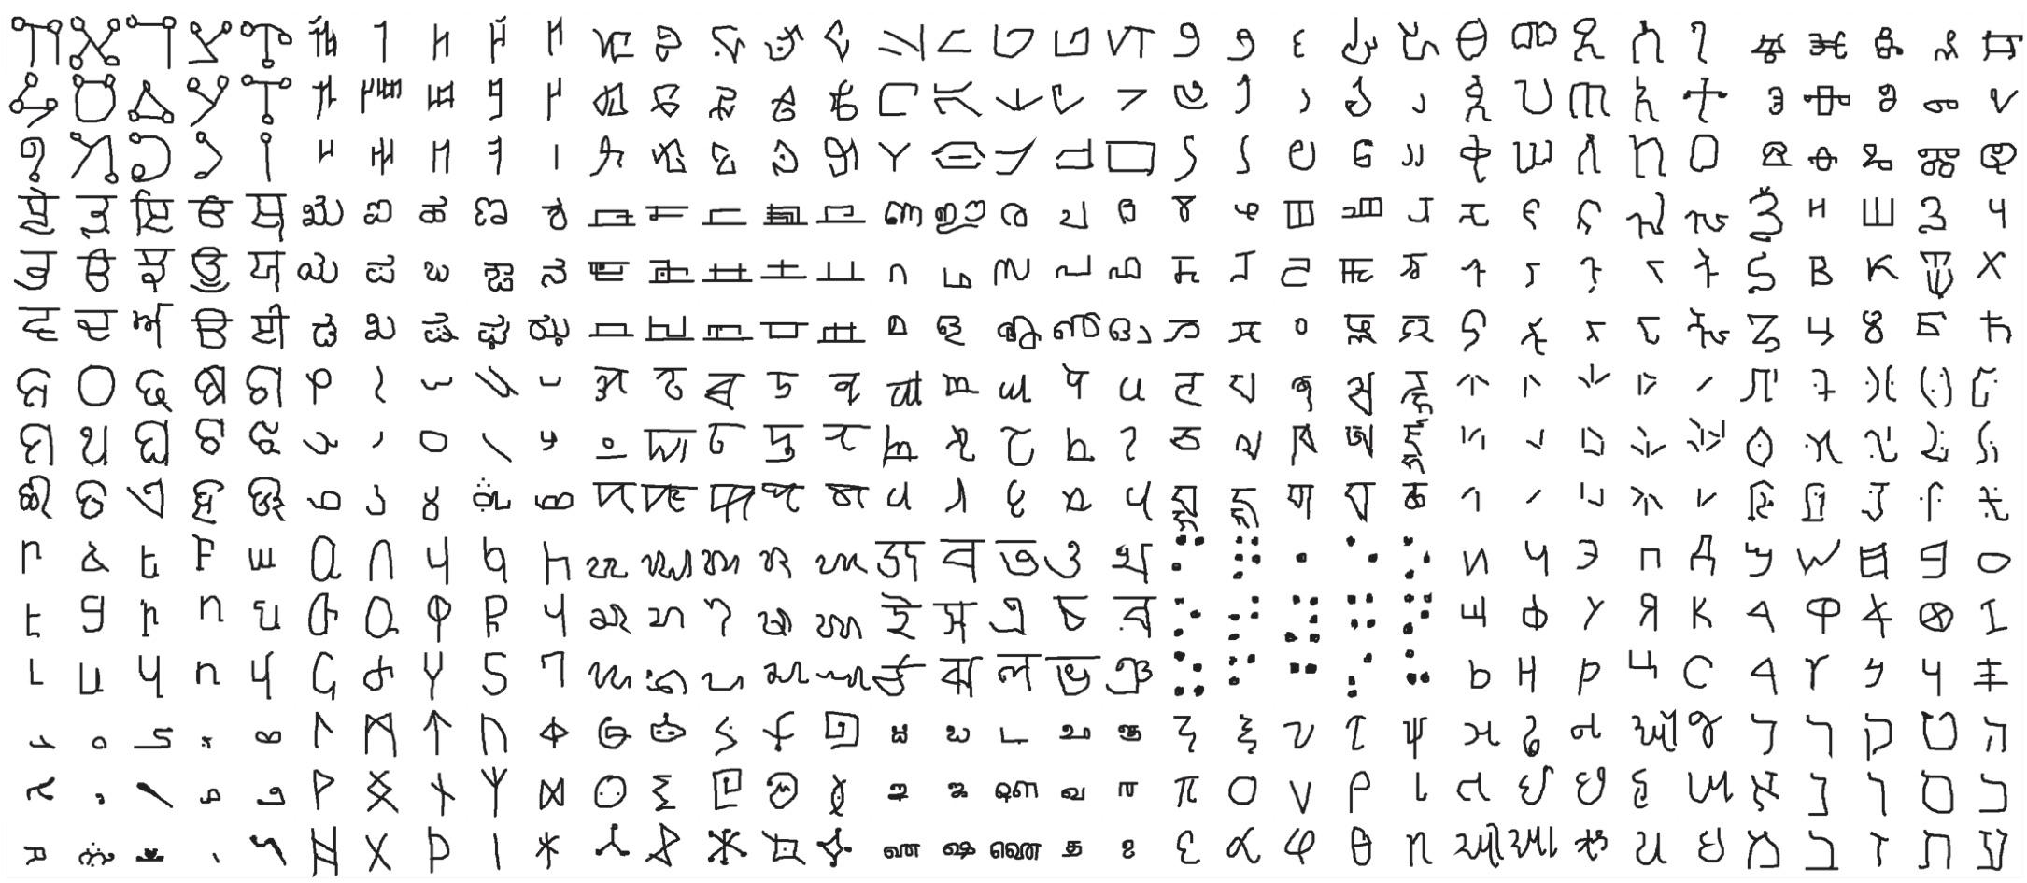
Omniglot Dataset
50 alphabets – 30 in train/validation set and 20 in evaluation set
Notes:
My first goal was to create a working architecture of a siamese network. The omniglot dataset was used to validate that the model was working as intended. It is a dataset consisting of 50 alphabets such as Arabic, Hebrew and Sanskrit. However, I only used 30 of the alphabets to accelerate the prototyping phase.
Each alphabet contains around 20 characters each, and each character has just 20 samples, which are 105 x 105 black and white images of handwritten drawings. The structure of the dataset, as well as the standardisation of its samples allowed me to focus on creating the model, rather than spend too much time preprocessing the data. Thus, I chose to use this dataset as a starting point.
(go through omniglot.ipynb)
- minimal preprocessing (loading dataset, making sample pairs)
- architecture of siamese network (2 of same CNN feeding feature vectors to dense layers -> sigmoid)

Slide 16
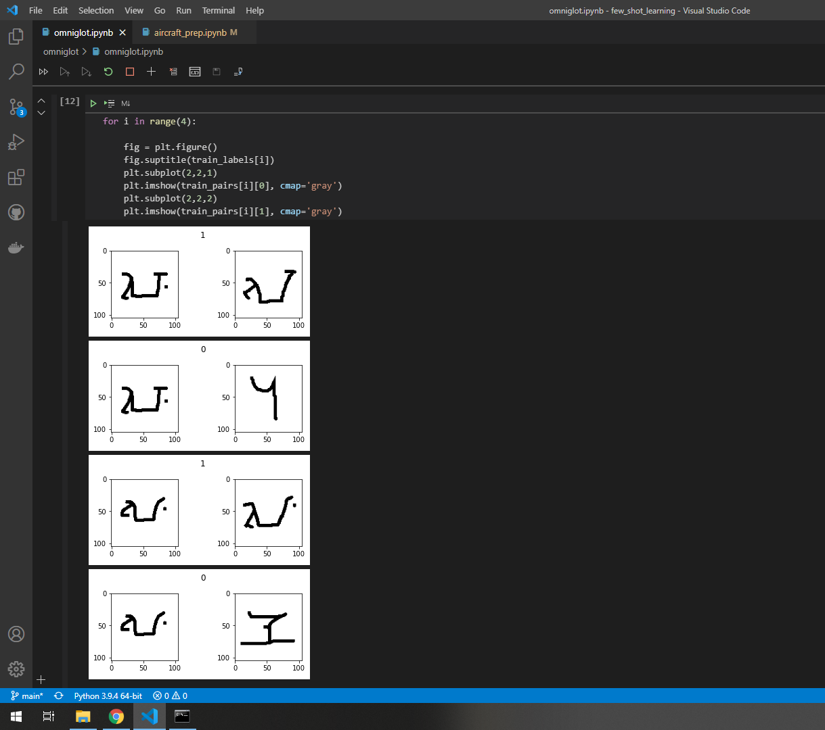
Notes:
This screenshot of the python notebook I created shows the pairing of images in our dataset. As we can see, the images are paired up and labelled with a 1 if they are of the same character, and 0 otherwise.

Slide 17
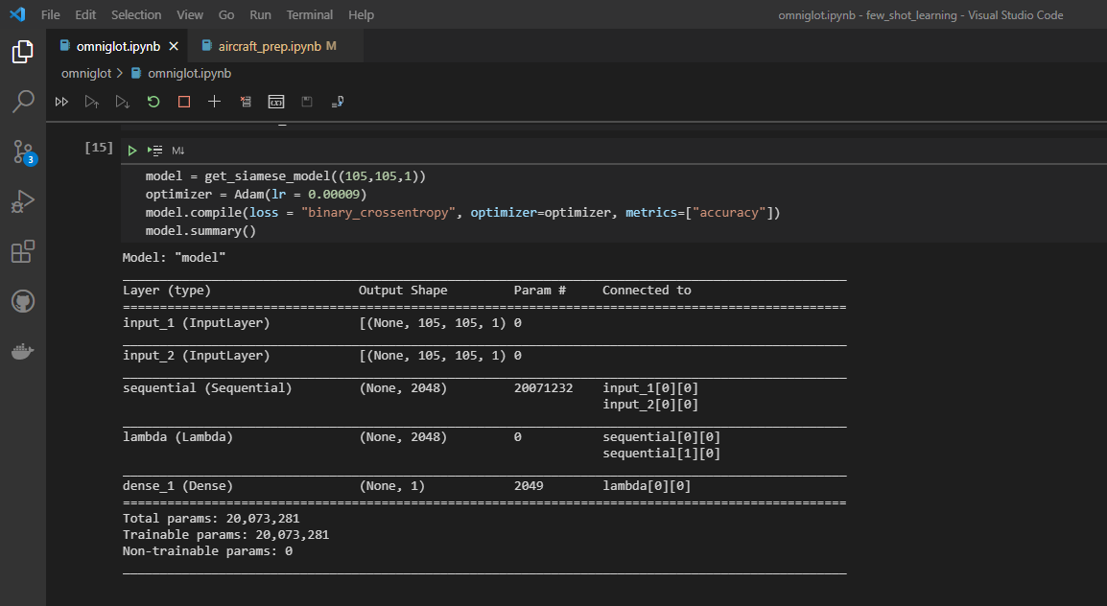
Notes:
And this screenshot is to show the architecture of the siamese network. As we can see there are 2 input layers, one for each image in the pair. These inputs are connected to a sequential layer, which is our convolutional neural network. Looking at the last column, we see that the neural network is connected to both inputs, which means that both images of the pair are passed through the same network.
The output of the sequential layer would be two feature vectors, where we can then find the absolute difference between the vectors, which is done by the Lambda layer. Finally, we pass the vector to a dense layer which outputs a similarity score between 0 and 1 using a sigmoid activation function.

Slide 18
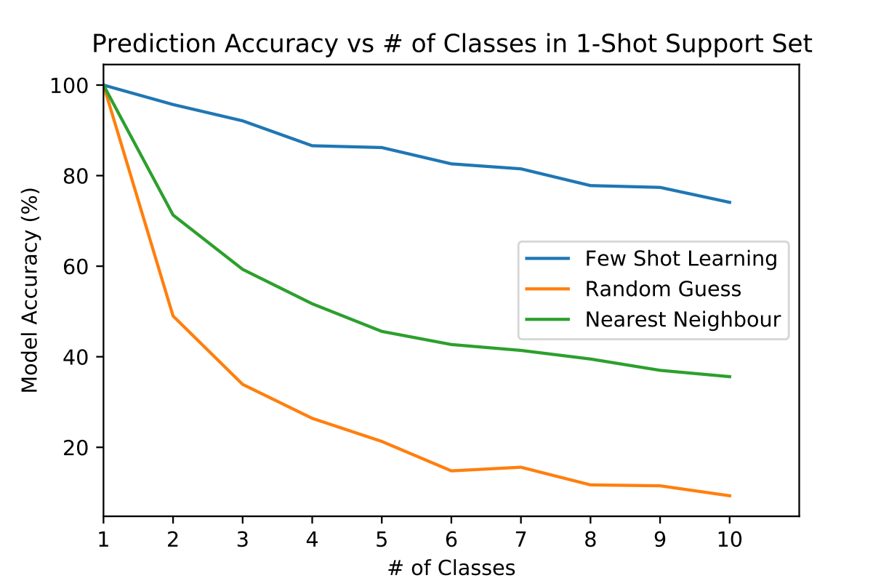
Siamese Network Results
Notes:
To ensure that the model was working, I tested it on various types of few-shot tasks using unseen alphabets in the dataset and plotted the results.
The x-axis is the number of classes in the support set, or the number of ways in the few shot task. I fixed the number of shots to be 1, which means each class of the support set has just one sample for comparison.
The y-axis is the accuracy of each model over one thousand randomly generated tasks of each type.
If we think of the MCQ analogy, going along the x-axis means there are more options to the question, thus it is more difficult to get the correct answer. Hence, we can expect the plots to trend downward.
As a sanity check, I compared it with a couple of baselines. First is the random guess model, which is shown by the yellow line.
The green line is the results of the nearest neighbour baseline. This baseline shows the resulting accuracy if we just took the sum of the absolute differences between each pixel value of the query image and the support image and predicted the class with the lowest difference.
As we can see, our trained model performs much better than both of the baselines, as expected.

Slide 19
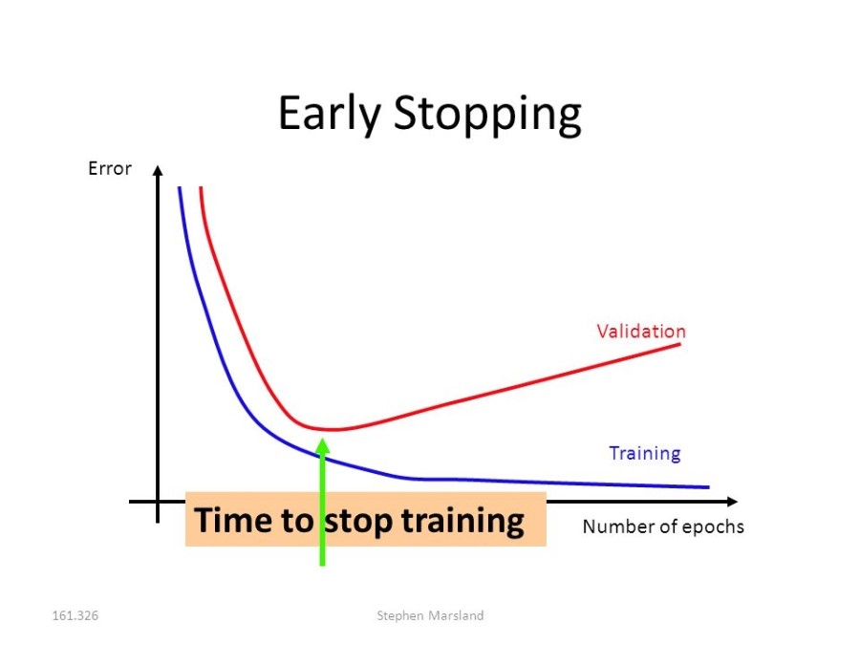
Notes:
After creating my first working prototype, I went to research more about how to improve the accuracy of this basic model.
The first significant idea was early stopping. What this means is to stop training after an optimal number of epochs. This optimal number is when test error is at its lowest.
The error on the validation set is used as a proxy for test error, therefore by stopping our training when validation loss begins to diverge from training error, we are able to create a model that performs better in out-of-sample tests.

Slide 20
Fine-tuning
Notes:
The second idea was to fine tune a pretrained model. Essentially, instead of training our model on just our omniglot dataset, we can train a model that has already been trained on large image datasets. The model is known as a pretrained model, and the additional training we do is called fine-tuning. This would hopefully result in a better model as the features extracted by the pretrained model is likely much closer to the optimal than a random initialisation of weights.
(return to omniglot.ipynb)
- show updated architecture for fine tuned model

Slide 21
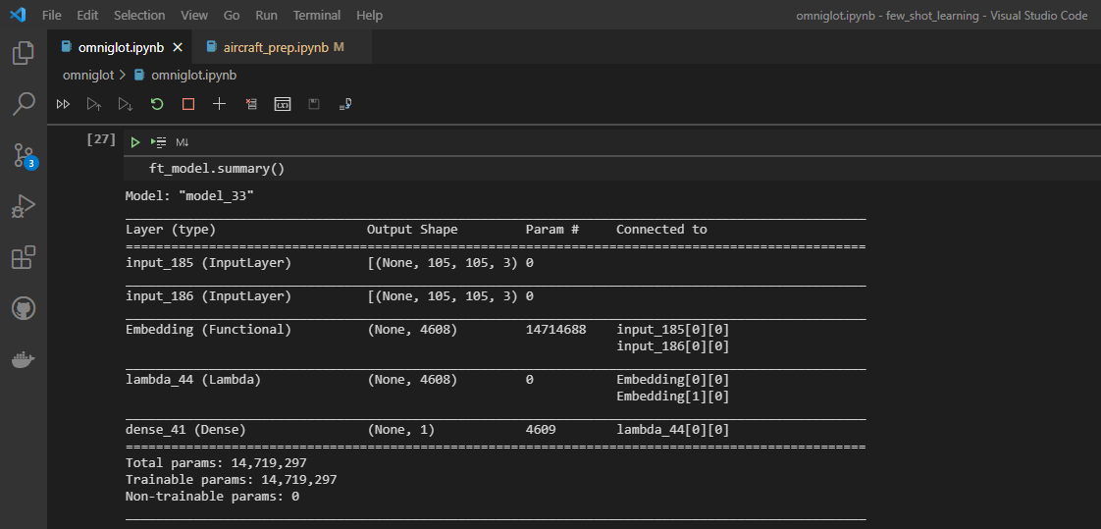
Notes:
This is a screenshot showing the updated architecture for our model. It is very similar to the previous one, except that instead of the sequential layer, we now have an embedding layer. This embedding layer represents the pretrained model.
For this project I decided to use vgg16 as the pretrained model.
Like before, we pass both images of each pair through the same pretrained model, and we can fine tune it by unfreezing the weights of its last few layers.

Slide 22
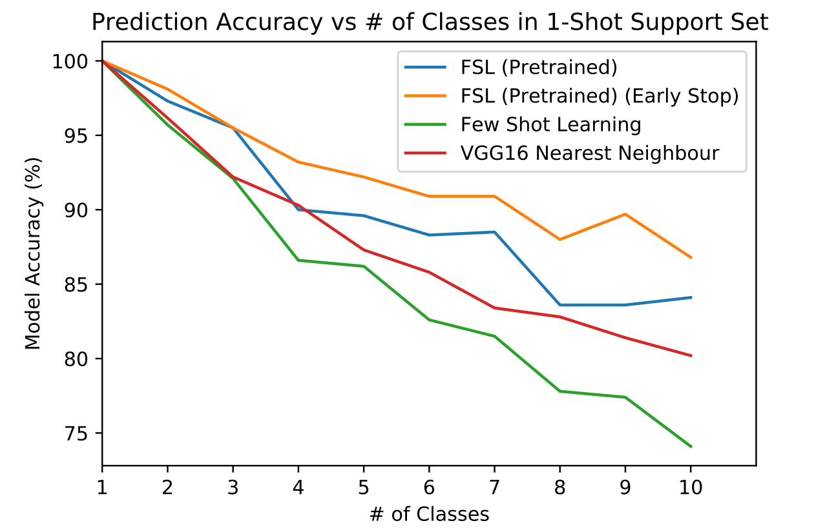
Fine-tuning Results
Notes:
The results of the two ideas are shown in this graph. The axes are similar to the previous graph. We can see from the yellow line that combining fine tuning with early stopping produced better results than only fine tuning, represented by the blue line, which in turn produces better results than the first model, seen in the green line.
The red line shows the VGG16 nearest neighbour baseline, which is similar to the previous nearest neighbour baseline, however, the absolute difference of the feature vectors from the pretrained model is calculated instead of the raw pixel values.
This interestingly performs better than the first model, suggesting that the feature vectors of the pretrained model are already more optimal than if we trained solely on the omniglot dataset, even though the pretrained model was trained on unrelated classes.

Slide 23
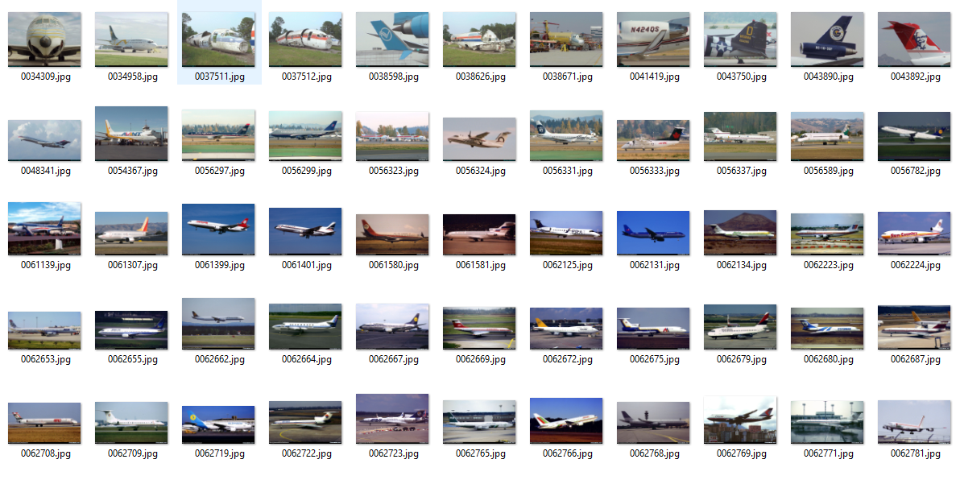
Fine Grained Visual Classification (FGVC) of Aircraft
Notes:
After learning how to create a siamese network and implement few shot learning with the model, I applied the same workflow as the omniglot dataset to a military aircraft one.
I used an open source aircraft dataset known as FGVC aircraft, and filtered out the commercial models, leaving with 30 classes that have some sort of military application. The 30 classes were split into 20 for training, 5 for validation and 5 for testing. Each class has 100 samples, which are coloured images of varying sizes taken at different angles.
(show aircraft_prep.ipynb)
- loading of dataset
- splitting into train, test, val sets
- making positive and negative pairs

Slide 24
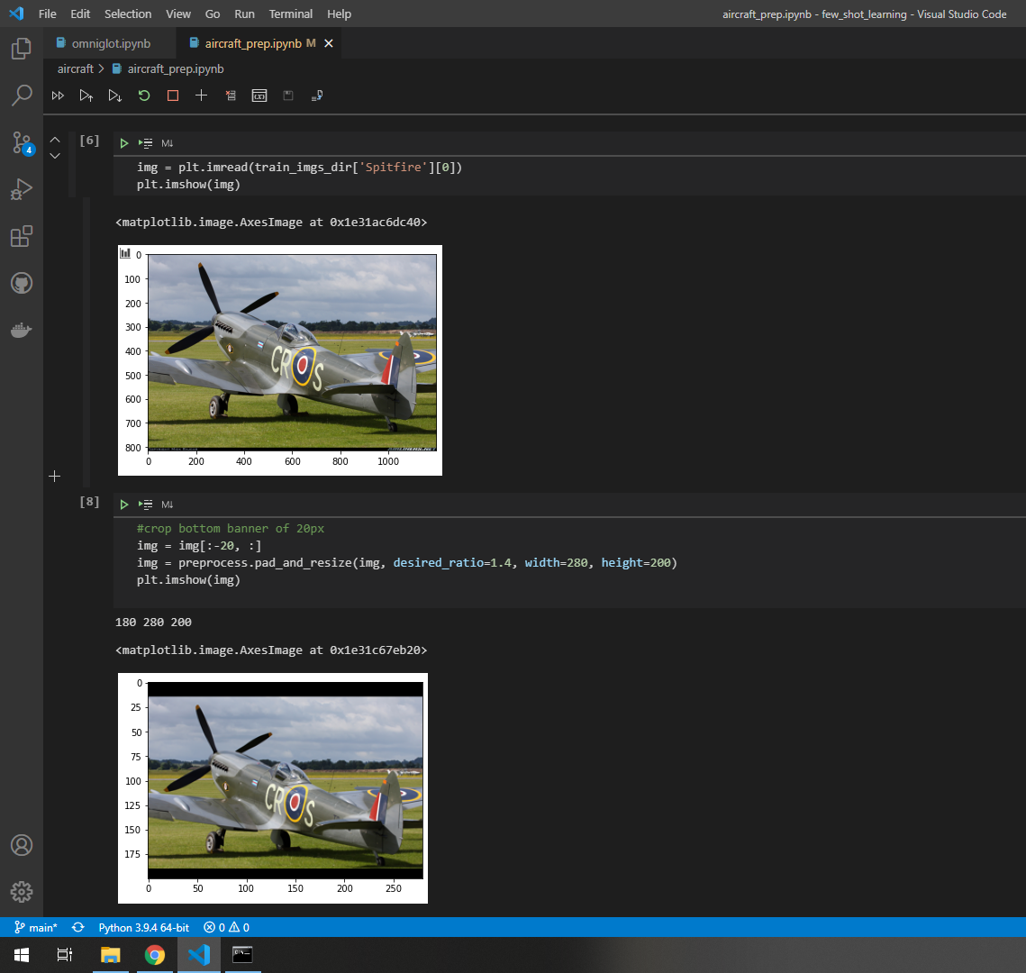
Notes:
Since our dataset contains images of different sizes, we have to perform some kind of preprocessing to ensure all the images are of the same dimensions before we are able to train the model.
And one way of doing this would be to simply resize the images, which would result in stretching or compressing of the images. Another way which I read produced better results would be to first pad the image with black borders to achieve a desired aspect ratio, before performing the resize. This would preserve the original image.

Slide 25
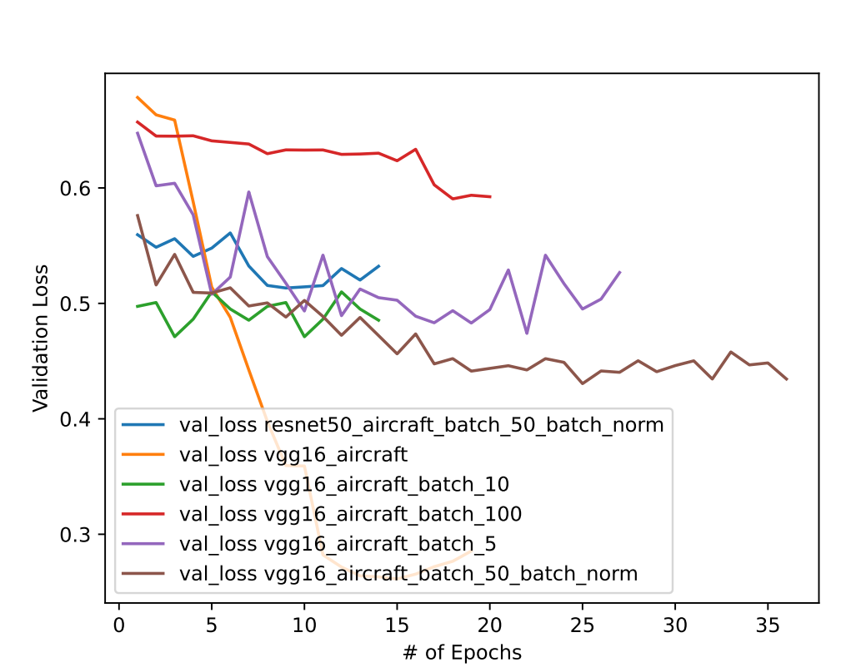
Minimising Generalisation Error
Notes:
The main challenge faced in this project was large generalisation error of the model. I experimented with multiple methods and various hyperparameter settings to minimise this.
And the results are shown in this graph. Basically, I got the best results from using batch normalisation and a batch size of 50, as seen by the brown line. Now, you make ask why the yellow line is not the best, and it’s because it was a mistake that I chose to leave in the graph because I think by explaining it will give further understanding to few shot learning. before that, I would like to quickly explain some of the methods I tried, which were varying batch sizes, batch normalisation and dropout.
One thing to note is that the reason why the plots are of different length is due to the early stopping callback, which would stop the training process when there has been no improvement to validation loss after a number of epochs.
Just to explain briefly the intuition behind the methods used:
Firstly, there is some literature to suggest that batch sizes affect generalisation ability of a neural network. The idea is that a relatively small batch size allows the model to 'jump' out of local minima due to the increased noise with each mini-batch. This optimal batch size needs to be found through experimentation, as too small a size may lead to poor convergence due to noise, while too large a size may cause convergence on local minima.
Secondly we have batch normalization, which is a technique for training neural networks that standardizes the inputs to a layer for each mini-batch. This has the effect of stabilizing the learning process and reducing the number of training epochs required.
And finally we have dropout, which is applied between two successive layers in a network. At each iteration a specified percentage of the connections are selected randomly and are ignored. This causes the subsequent layer to rely on all of its connections to the previous layer.
Now, I would like to address why the yellow line did not represent the best results.

Slide 26
Notes:
This is because the validation set that was used to evaluate the model after every epoch was a subset of the training set. This is normally what you would do in image classification. Let’s say, if we only wanted to detect the following classes in the training set (husky, elephant,...). And we had many images of all these classes. This means that at testing stage, we are giving images from those classes only and asking the model to classify them. Thus, it makes sense to split our dataset horizontally into training and validation sets. That means we have a few images of every class in both training and validations set.

Slide 27
Notes:
However, in few shot learning, the assumption is that we only have few images of the class we would like to detect. And as we discussed, we only use those few images we have as support images for our model at testing, meaning to say that our model is not trained on any image from the class we are testing it on.
Again, let’s say for example we have the following dataset, our end goal would instead be to detect some image of a rare animal not from any of the classes in the dataset, such as this image on the right.
In this case, it would make sense to split the dataset vertically instead, meaning we train our model on all images of the first 3 classes, for example, and validate it on all images from the remaining 2 classes. The resulting validation error would be more realistic since it better simulates how the model would perform at test time, when it is given images of unseen classes.

Slide 28
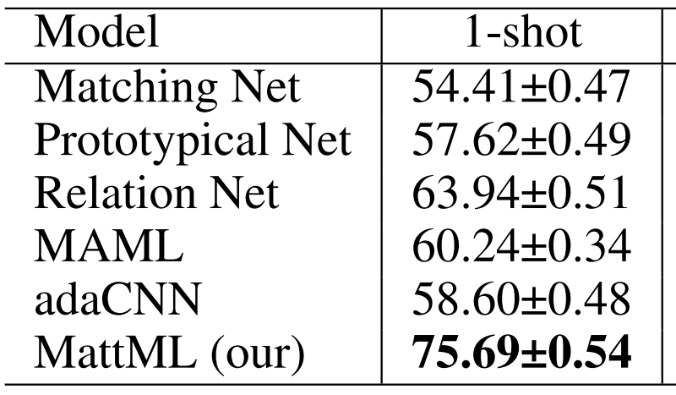
State Of the Art
Multi-attention Meta Learning for Few-shot Fine-grained Image Recognition (Yaohui Zhu, Chenlong Liu, Shuqiang Jiang)
5-way 1-shot results using 65/100 variants in dataset (my model was trained on 20/70 families of the dataset)
An aircraft family comprises of multiple variants (e.g Boeing 737 is a family. Its variants including 737-200, 737-300, etc)
Our model achieves 65.8% accuracy on 5-way 1-shot tasks
Notes:
For comparison purposes, I found a publicly available paper that used the same aircraft dataset and also applied a few shot algorithm on it. This paper published the 5-way 1-shot accuracies for its own model as well as various others as seen in the table. My model was able to achieve an accuracy of 65.8% over 1000 5-way 1-shot tasks. However, the percentages cannot really be used for comparison for a few reasons.
Firstly, the paper tested the models on aircraft model variants instead of aircraft families. The model variant is more specific than a family, thus it can be said that it is more difficult to correctly classify model variants. That being said, the models were trained on 65 out of 100 of the variants in the dataset, while my model was only trained on 20 out of 70 aircraft families, since I had filtered out the commercial aircraft images from the dataset.
After doing what I could to maximise the model's accuracy, I used FastAPI to create a simple web-service that would take user uploaded images to query the model and return a predicted class. I used Docker to containerise this web service.
(demo of web-service via Docker image)
So, we can run the docker image on the terminal. After it has loaded, we can access the web service through a local server.
This is the homepage. It is very basic, and just has some instructions for the user on how to organise the query and support image files into a folder. The user can then browse the file explorer to select this folder and upload it to the web service. I’m not sure why the file explorer was not recorded but it does appear for the user to search.
After submitting, each query image is paired up with every support image and the pairs are passed through the siamese network which outputs the similarity scores, which are displayed on the browser. For each query, the class with the highest score is highlighted.
Since this is an example, the class of the query image is given for demonstration purposes. And from this we can see the model is not perfect, but some inaccuracy is to be expected as again, the model is not trained on any image from the query class.

Slide 29
Summary
Created a script to train/test a siamese network
Can be adapted to various other datasets and use-cases
Containerised web-service for users to roughly explore possible use-cases due to high generalisability of model
Notes:
To quickly summarise, over this 2 month internship, I created a Python script to train and test a siamese network, and applied this to the omniglot and the aircraft dataset. The code may be adapted to various other datasets or use cases, providing some foundation for further exploration into the concept of one shot learning.
I also containerised a web-service using docker which allows users to upload query and support images to obtain a prediction from a sample model. This may be used to roughly explore possible use cases for one shot learning.
I would like to thank Director for this internship opportunity, as I learnt many new things, especially during the front-end phase of the project.
And I would also like to thank my mentor, Le Tang, for his patience in explaining new concepts to me. And even though a lot of the days were spent working from home, I was still able to learn a lot from him about the work and the culture at DSTA.
Thank you.

Slide 30
THANK YOU!

Slide 31
Credits
Images adapted from:
The Hundred-Page Machine Learning Book by Andriy Burkov
https://github.com/brendenlake/omniglot
https://www.kdnuggets.com/2016/11/intuitive-explanation-convolutional-neural-networks.html/3
https://www.researchgate.net/figure/Example-of-an-artificial-neural-network-of-multiple-layers-and-multiple-outputs-22_fig2_328822075
https://deeplearningdemystified.com/article/nlp-1
https://github.com/wangshusen/DeepLearning
https://www.ijcai.org/proceedings/2020/0152.pdf

